Slide 1
Recommender Systems
Overview of Recommender Systems
Recommender Systems and Artificial Intelligence
Real World Challenges for Recommender Systems
Applications and Scope of Recommender Systems
Shahzaib Hamid

Slide 2
Overview
Recommender Systems
Recommender Systems Process
Goals of Recommender Systems
Generations of Recommender Systems
Nexus of Recommender Systems and Artificial Intelligence
Real World Challenges of Recommender Systems
Applications of Recommender Systems

Slide 3
Recommender Systems
Emerged in 90’s, gained a boost in recent years.
Reason for paradigm shift from ecommerce to online advertisements.
Typically, algorithms aiming to suggest relevant items to user.
Predicts user’s interests and recommend items interesting to them.
Companies use these systems to boost their sales in a very personalized manner.
Improves user experiences by making platform more desirable and addictive.

Slide 4
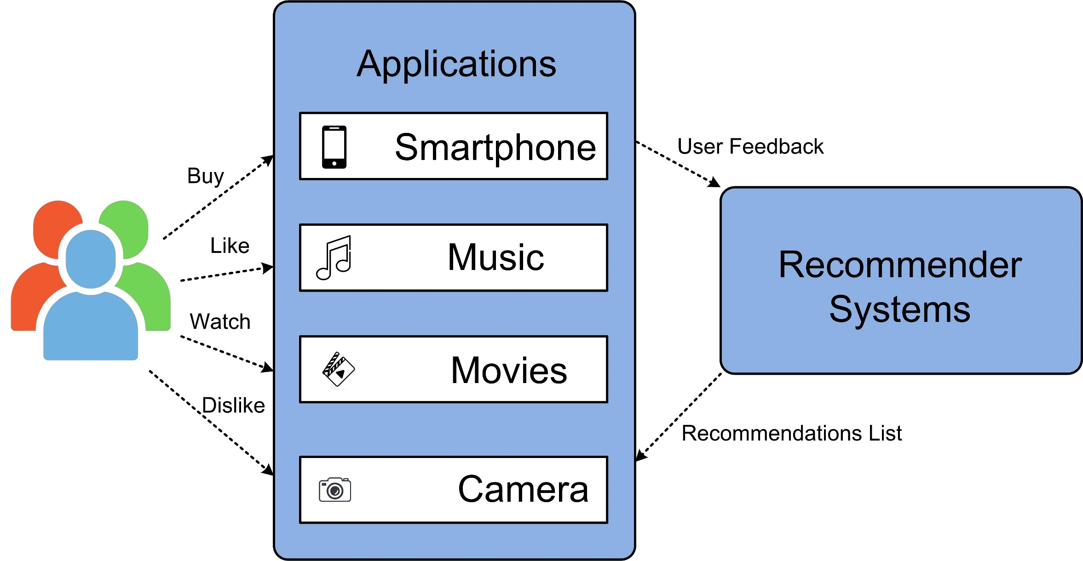
Recommender Systems Process

Slide 5
Goals of Recommender Systems
Relevance
Recommend items to a user that are more relevant
User will consume items that are more relevant
Novelty
Recommender systems are effective when the recommended item is not old
Repeated recommendations can also lead to reduction in sales
Serendipity
Recommended items should be more surprising to the user
Example: An Italian hotel in Italy will not surprise the customer
Example: An Indian hotel in Italy may surprise the customer
Increasing recommendation diversity
Recommended items should be of different but relevant types
Diversity has the benefit of ensuring that the user does not get bored

Slide 6
Generations of Recommender Systems
1st Generation Recommended Systems
Knowledge-based Recommender Systems
Content-Based Recommender Systems
Collaborative Filtering Based Recommender Systems
Hybrid Recommender Systems
2nd Generation Recommended Systems
Matrix Factorization Based Approach
WUM (Web Usage Mining) Based Recommender Systems
Personality Based Recommender Systems
3rd Generation Recommended Systems
Deep Content-based Recommendation Systems
Product Based Recommender System
DL-Collaborative Recommended System
Restricted Boltzmann Machines and Collaborative Filtering

Slide 7
Nexus of Recommender Systems and Artificial Intelligence
Artificial intelligence recently has changed the dynamics of recommendation systems
Enhanced the user experience and increase user satisfaction.
Created advanced insights into the relationships between users and items
Presented more complex data representations
Discovered comprehensive knowledge in demographical, textural, virtual and contextual data
AI, data analytics and big data present a great opportunity for recommender systems to embrace the impressive achievements of AI

Slide 8
Artificial Intelligence in Recommender Systems
Deep neural networks in recommender systems
Multi-layer perceptron-based recommender systems
Autoencoder-based recommender systems
Convolutional neural network-based recommender Systems
Recurrent neural network-based recommender systems
Graph neural network-based recommender systems
Generative adversarial network-based recommender
Transfer learning in recommender systems
Active learning in recommender systems
Reinforcement learning in recommender systems
Natural language processing in recommender systems

Slide 9
Real World Challenges of Recommender Systems
Cold Start
Data Sparsity
Privacy
Scalability
Changing User Preferences
Autonomy and personal identity
Sparsity
Synonymy
Complex onboarding process

Slide 10
Applications of Recommender Systems
Applications of recommender systems are not limited to only these
Amazon
Books
Netflix
Movies
Jester
Jokes
GroupLens
News
MovieLens
Movies
last.fm
Music
Google News
News
Google Search
Advertisements
Facebook
Friends
Pandora
Music
Youtube
Online Videos
IMDb
Movies
Dramas
Documentaries
Articles
Reports
Editorials
Dramas
Short Stories
Web Series
Stores
Related products
Articles
Reports
Surveys
Advertisements
Stories
YT Shorts
Channels
Dramas
Web Series
Short Films

